Slide 1


MOOCLink: Building and Utilizing Linked Data from Massive Open Online Courses
Sebastian Kagemann
Indiana University
Srividya Bansal
Arizona State University

Slide 2



MOOCs
Notes:
Introduction (needs to be condensed): Massive Open Online Courses or MOOCs are online courses accessible to anyone on the web. Hundreds of institutions have joined in an effort to make education more accessible by teaming up with MOOC providers such as Coursera, edX and Udacity, the three providers whose data we incorporate into our linked data. Delivering course content through lecture videos as well as traditional materials such as readings and problem sets, MOOCs encourage interactivity between professors and students around the world by way of discussion forums and graded assessments.
With the advent of websites providing these courses, it is difficult to discern which classes are best-suited to someone’s interests or learning goals. Basic information about courses and their curriculums available on course websites allow users to assess this to an extent, however manually comparing several courses teaching similar material can be tedious. As a result, there are a handful of existing websites such as Class Central that aggregate MOOCs from different providers and allow users to compare and rate courses. They have a weakness however in that they do not allow the user to do things such as search and compare courses on specific topics, the length of the course, and other basic data which is openly available from MOOC providers. Given the data provided by these MOOC providers (by API or openly on their webpages), we saw an opportunity to allow more specific search incorporating things such as syllabi details, course length, recommended background, and how these relate to one another as Linked Data.
The result of this is an in-development web app, MOOCLink, which creates Linked Data from online course information and utilizes that data to discover and compare online courses.

Slide 3



Existing Linked Education Data Specifications
Notes:
IEEE-LOM is encoded in XML and includes nine categories with sub-elements that hold data.
An RDF binding for LOM exists [9], however development is halted at the time of this paper’s writing.
SCORM is an extensive technical standard, typically encoded in XML, that defines how educational content should be packaged, how it is delivered, and how learners navigate between different parts of an online course.
An RDF binding of SCORM has yet to be developed.
2013, Learning Resource Metadata Initiative (LRMI) specification was incorporated into Schema.org’s vocabulary for tagging educational content [13].
Rather than using the defunct LOM binding or creating a new binding of SCORM to RDF, we chose to extend a vocabulary meant for Linked Data, Schema.org, for which an RDF mapping exists [12], to include properties unique to open courseware.

Slide 4
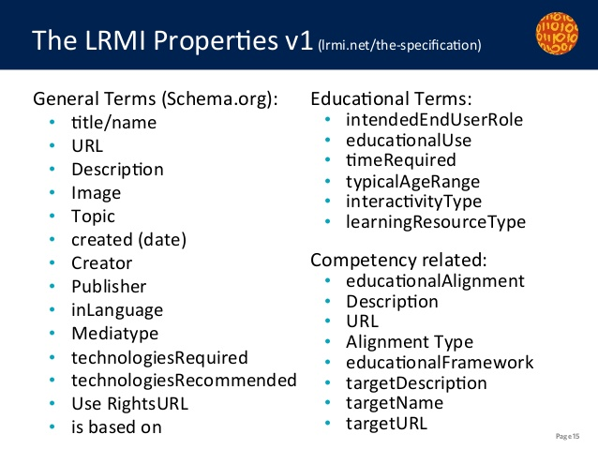
Learning Resource Metadata Initiative (LRMI)
Notes:
Schema.org is organized as a hierarchy of types, each associated with a set of properties.
CreativeWork is Schema.org’s type for generic creative work including books, movies, and now educational resources.
The LRMI specification adds properties to CreativeWork including:
the time it takes to work through a learning resource (timeRequired)
the typical age range of the content’s intended audience (typicalAgeRange)
LRMI also highlights properties previously available in Schema.org’s CreativeWork type relevant to Learning Resource data like the subject of the content (about) and the publisher of the resource (publisher).
Still several crucial missing data fields such as syllabus details, course difficulty, and predicates linking courses to other objects -> necessary to extend the vocabulary for MOOC data.

Slide 5
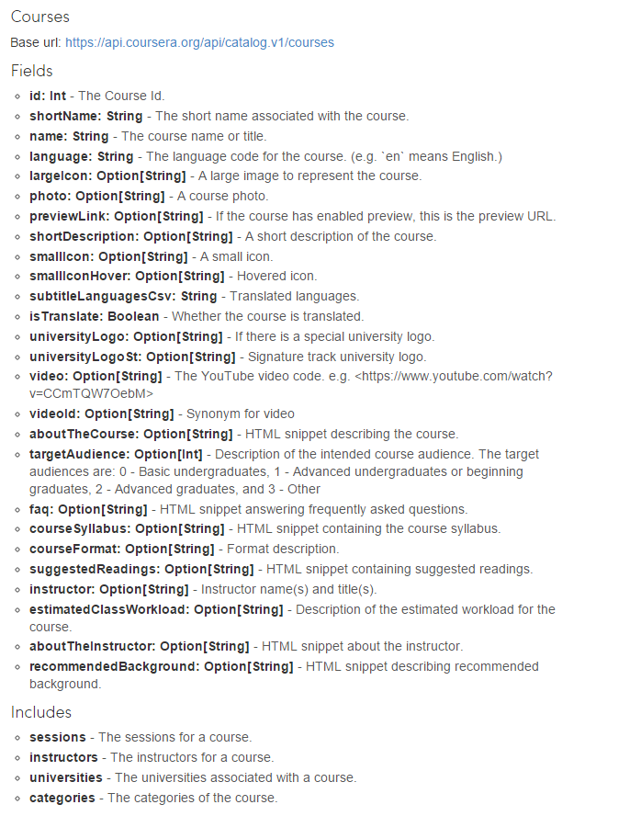
MOOC Data
Data Fields from Coursera API
edX Course Page
Udacity Course Page
Notes:
- More properties than there are in existing linked education data specifications. Further demonstrating need for Schema.org extension.
- Similarities in properties between providers. All have curriculum details available.
- Mapping categories manually.

Slide 6
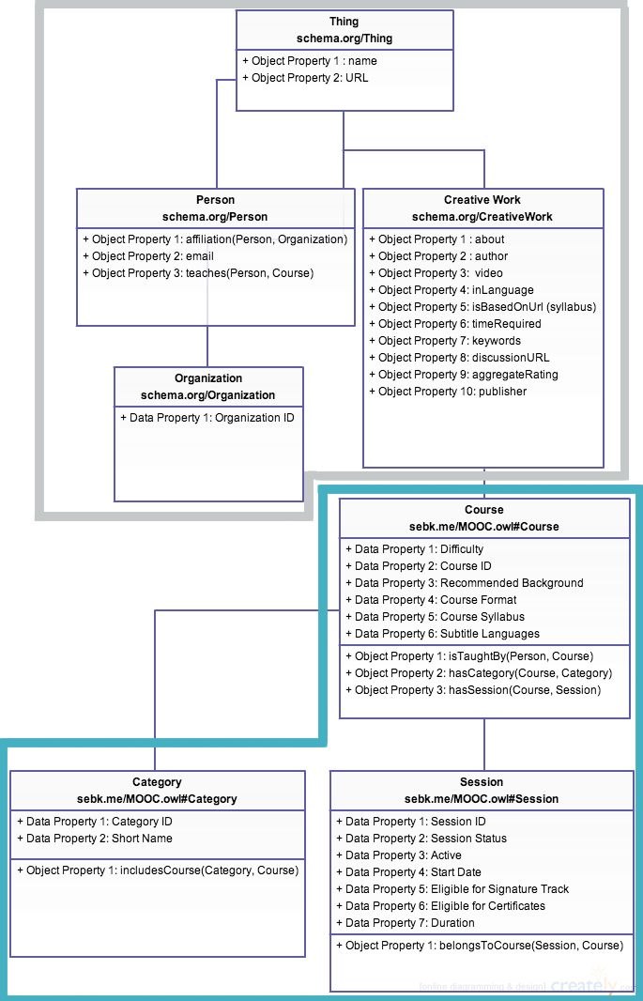
Extending Schema.org
Relevant
Schema.org
properties
Extended
MOOC
properties
Notes:
Schema.rdfs.org hosts an RDF/XML version of Schema.org’s ontology, which we imported into Stanford Protégé to extend with additional types and properties.
Relevant properties are highlighted from LRMI specification
Data properties adapted from Coursera
Object properties relate types to one another

Slide 7
Linked Data Generation
Defining web crawler
class EdXSpider(CrawlSpider):
name = "edx"
allowed_domains = ["edx.org"]
start_urls = []
file = open('data/category_map', 'r')
for line in file:
url="https://www.edx.org/course-list/allschools" + line.strip() + "/allcourses"
start_urls.append(url)
def parse_sites(self, response):
filename = response.url.split("/")[-2]
open(filename, 'wb').write(response.body)
sel = Selector(response)
sites = sel.xpath('//strong/a/@href').extract()
sites.pop(0) # remove home directory link
requests = []
Parsing start_urls
def parse_details(self, response):
filename = response.url.split("/")[-2]
open(filename, 'wb').write(response.body)
sel = Selector(response)
item = response.meta['item']
item['name] = sel.xpath('//h2/span/text()').extract()
item['about'] = sel.xpath('//*[@itemprop="description"]').extract()
item['instructor']=sel.xpath('//*[@class="staff-title"]/text()').extract()
item['school']=sel.xpath('//*[@class="course-detail-school item"]/a/text()').extract()
item['courseCode']=sel.xpath('//*[@class="course-detail-number item"]/text()').extract()
item['startDate']=sel.xpath('//*[@class="course-detail-start item"]/text()').extract()
item['length']=sel.xpath('//*[@class="course-detail-length item"]/text()').extract()
item['effort']=sel.xpath('//*[@class="course-detail-effort item"]/text()').extract()
item['prereqs']=sel.xpath('//*[@class="course-section course-detail-prerequisites-full"]/p/text()').extract()
item['video']=sel.xpath('/html/head/meta[@property="og:video"]/@content').extract()
return item
Parsing individual websites
Notes:
(Needs to be condensed)
Web scrapers were necessary to collect data not available by API (Coursera was the only provider with one).
- First we subclass a CrawlSpider, define its name, allowed domains, as well as a list of URLs for the crawler to visit first. The subsequent lines of code open a list of edXcategories, iterate through those categories and append URLs to start_urls. These appended URLs lead to paginated lists of courses in each category. This method was necessary as Category names are currently not explicitly defined on each edX course page.
Next we write our first parse method which takes a URL from our list of start URLs defined in Figure 3, selects each course URL listed on the page using the XPath selector “//strong/a/@href”, then iterates through each site. For each site, a new EdxItem is declared, “url” and “category” are assigned, and a new scrapy.Request is made for the URL selected, calling the parse_details method detailed in Figure 5. The complete EdxItem is then assigned to the Request.meta attribute, and the request is appended to a list of every request made during the crawl.
The next method, parse_details, collects attributes from individual course pages using XPath selectors. The majority of these selectors are tailored to the HTML classes provided by edX, which denote course properties provided on the course page. <This is susceptible to error if edX changes the class names of their course properties.

Slide 8
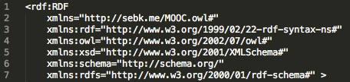
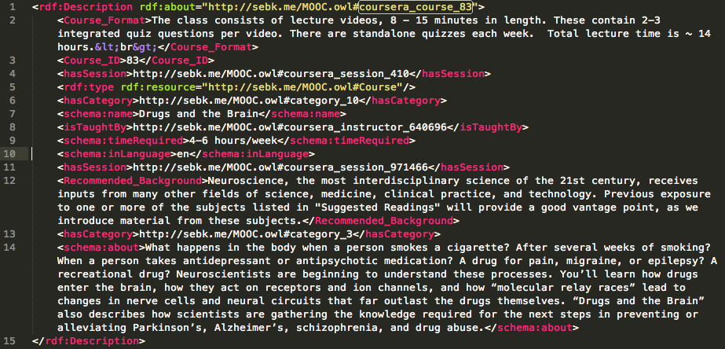
MOOC RDF/XML
Notes:
- Conversion from JSON to RDF/XML was done in Apache Jena by importing the ontology and mapping properties to our linked data properties.
- Not all of the properties are seen in this sample data.
- Data cleansing is needed to remove tags.

Slide 9



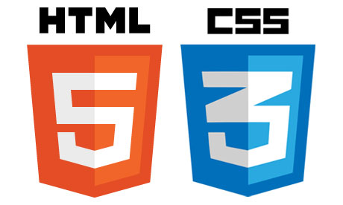
Semantic Web Stack
Notes:
A semantic web stack of Apache Tomcat as the web server and servlet container, Fuseki as the SPARQL server, TDB as the RDF store, and JavaServer Pages and Java Servlets to dynamically create webpages is used for our web app.
- Could talk about the ease of use of this stack compared to a popular web framework like RoR.

Slide 10
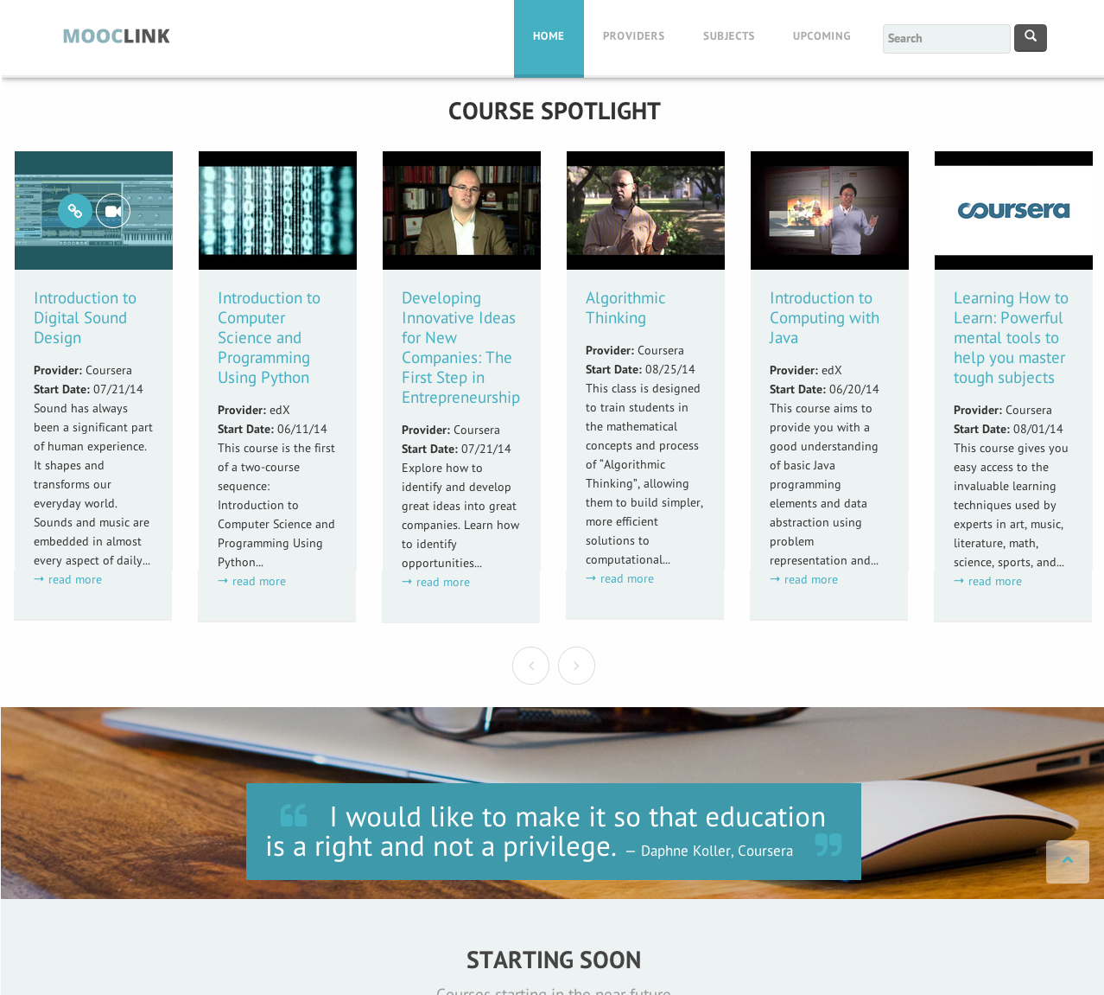
MOOCLink
Notes:
MOOCLink is a web application which aggregates online courses as Linked Data and utilizes that data to discover and compare online courseware.
Bootstrap template
Course spotlight, how that is populated
Starting soon section
Link to GitHub, open-source

Slide 11
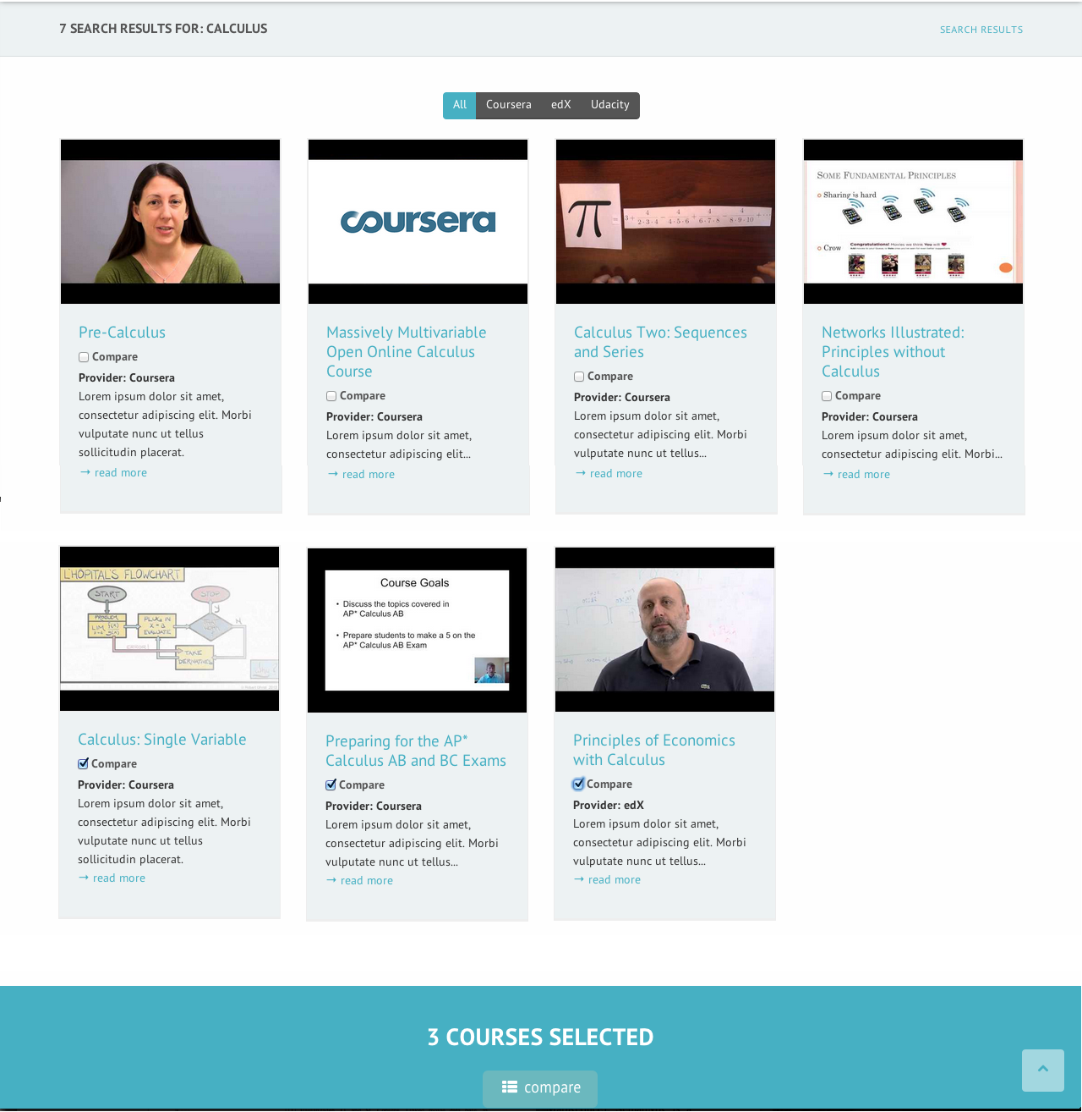
Search
Notes:
Search UI
- Search on syllabi details, course length, etc.
- Select courses to compare

Slide 12
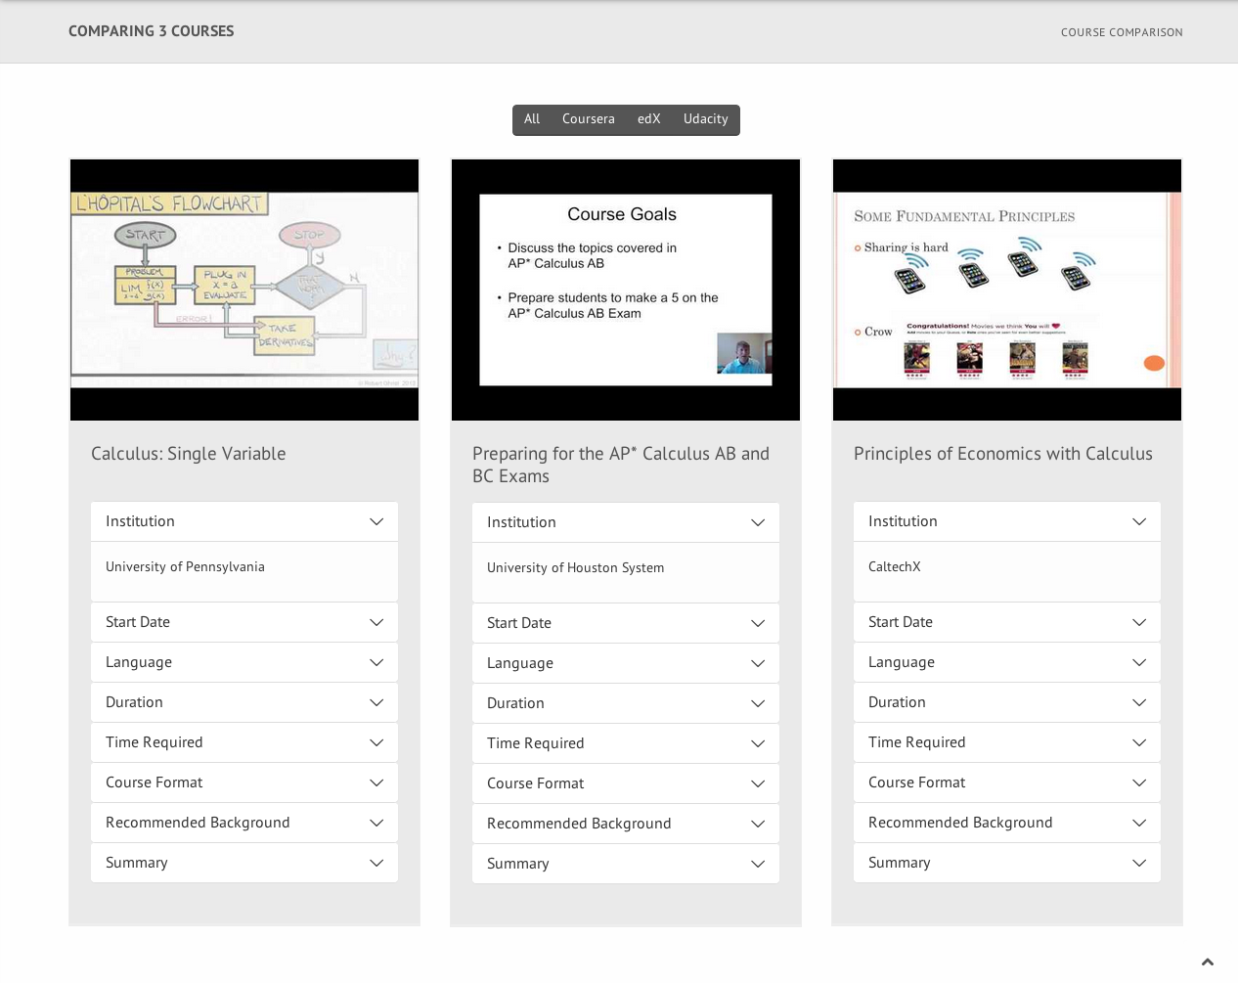
Course Comparison
Notes:
Course Comparison
Side-by-side course comparison
Drop-down lists expand course properties for each class

Slide 13
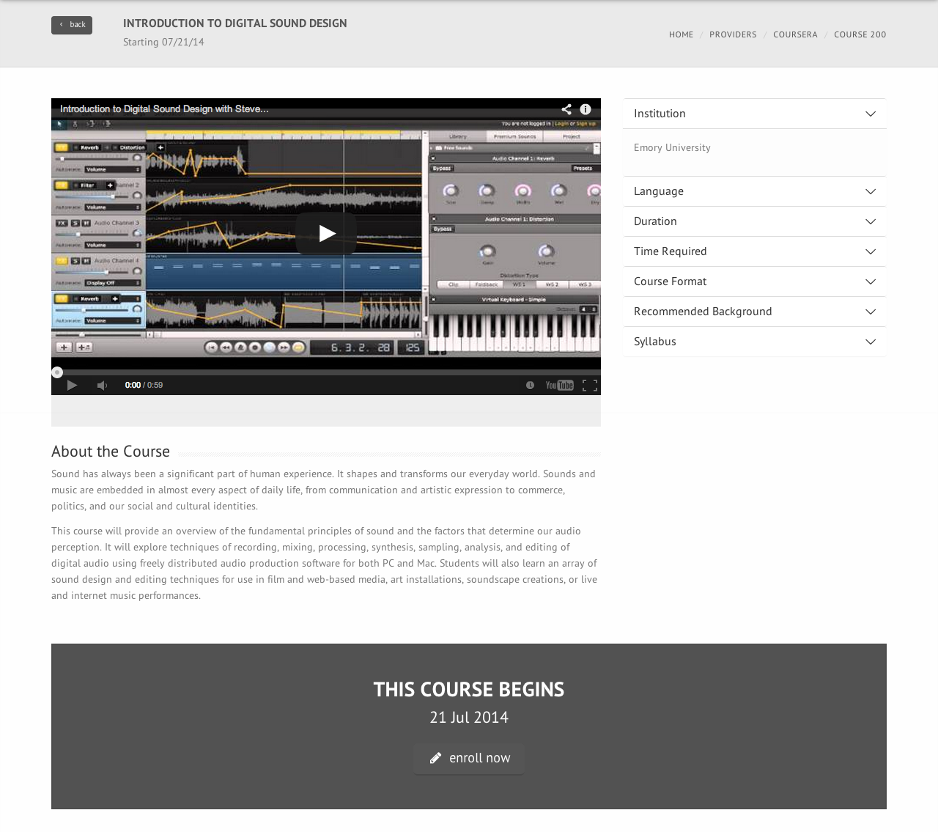
Course Details
Notes:
Course Details
All information collected in the linked data
May add similar courses based on categories, similarities in syllabi, etc.
Link to course page on the respective MOOC provider

Slide 14
Conclusion
We have presented:
An extension of Schema.org’s Linked Data vocabulary, which incorporates assignment of data properties relevant to online courses as well as object properties which link MOOC sessions, course details, categories and instructors together between different providers.
An approach to collecting data from web crawlers and APIs as JSON and converting it to RDF with Apache Jena.
A prototype implementation of MOOCLink, a web application which utilizes Linked MOOC Data to allow users to discover and compare similar online courses.
Notes:
Challenges:
Custom-tailoring a data generation pipeline (crawling, data cleansing, converting to RDF) to each new MOOC provider—we’ll see if it’s worth is when there is more development on the semantic search functionality.
Making semantic search capabilities intuitive to users (overlap with future work)

Slide 15
Future Work
Incorporating demographic data
Review system
Item pipeline for crawlers
Automated web updates
Course tracks
Natural language processing of syllabi
Extended search functionality

